Slide 1
Home Credit Default Risk

Slide 2
Problem Statement
Home Credit strives to broaden financial inclusion for the unbanked population by providing a positive and safe borrowing experience. Building a model to predict how capable each applicant is of repaying a loan, so that sanctioning loan only for the applicants who are likely to repay the loan.

Slide 3
Dataset
application_{train|test}.csv
This is the main table, broken into two files for Train (with TARGET) and Test (without TARGET).
Static data for all applications. One row represents one loan in our data sample.
bureau.csv
All client's previous credits provided by other financial institutions that were reported to Credit Bureau (for clients who have a loan in our sample).
For every loan in our sample, there are as many rows as number of credits the client had in Credit Bureau before the application date.
bureau_balance.csv
Monthly balances of previous credits in Credit Bureau.
This table has one row for each month of history of every previous credit reported to Credit Bureau – i.e the table has (#loans in sample * # of relative previous credits * # of months where we have some history observable for the previous credits) rows.

Slide 4
POS_CASH_balance.csv
Monthly balance snapshots of previous POS (point of sales) and cash loans that the applicant had with Home Credit.
This table has one row for each month of history of every previous credit in Home Credit (consumer credit and cash loans) related to loans in our sample – i.e. the table has (#loans in sample * # of relative previous credits * # of months in which we have some history observable for the previous credits) rows.
credit_card_balance.csv
Monthly balance snapshots of previous credit cards that the applicant has with Home Credit.
This table has one row for each month of history of every previous credit in Home Credit (consumer credit and cash loans) related to loans in our sample – i.e. the table has (#loans in sample * # of relative previous credit cards * # of months where we have some history observable for the previous credit card) rows.
previous_application.csv
All previous applications for Home Credit loans of clients who have loans in our sample.
There is one row for each previous application related to loans in our data sample.
installments_payments.csv
Repayment history for the previously disbursed credits in Home Credit related to the loans in our sample.
There is a) one row for every payment that was made plus b) one row each for missed payment.
One row is equivalent to one payment of one installment OR one installment corresponding to one payment of one previous Home Credit credit related to loans in our sample.

Slide 5
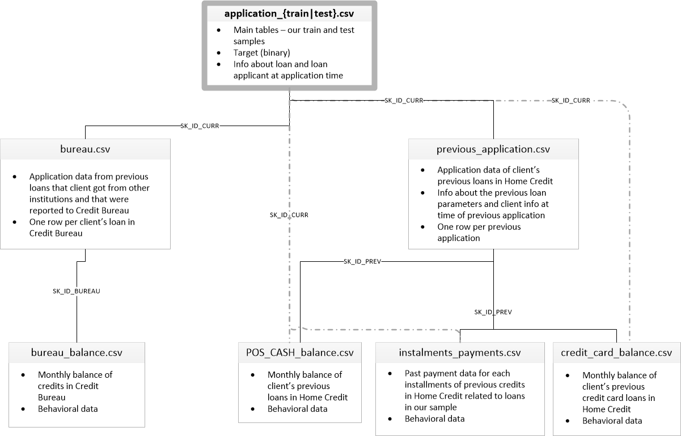
Relation between various CSVs

Slide 6
Memory utilisation
File | Memory usage | Memory usage after optimisation
application.csv | 286.23 MB | 59.54 MB
bureau.csv | 222.62 MB | 78.57 MB
bureau_balance.csv | 624.85 MB | 156.21 MB
previous_application.csv | 471.48 MB | 130.62 MB
credit_card_balance.csv | 673.88 MB | 263.69 MB
installments_payments.csv | 830.41 MB | 311.40 MB
POS_CASH_balance.csv | 610.43 MB | 171.69 MB
Notes:
Optimization is basically done by changing the data types according to min-max values in the columns.

Slide 7
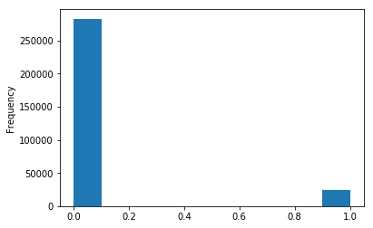
Exploratory Data Analysis
Binary target variable is heavily imbalanced
and is distributed at roughly 8%/92%
High number of columns (67)
with missing values
Analysis of different features
in every CSV file

Slide 8
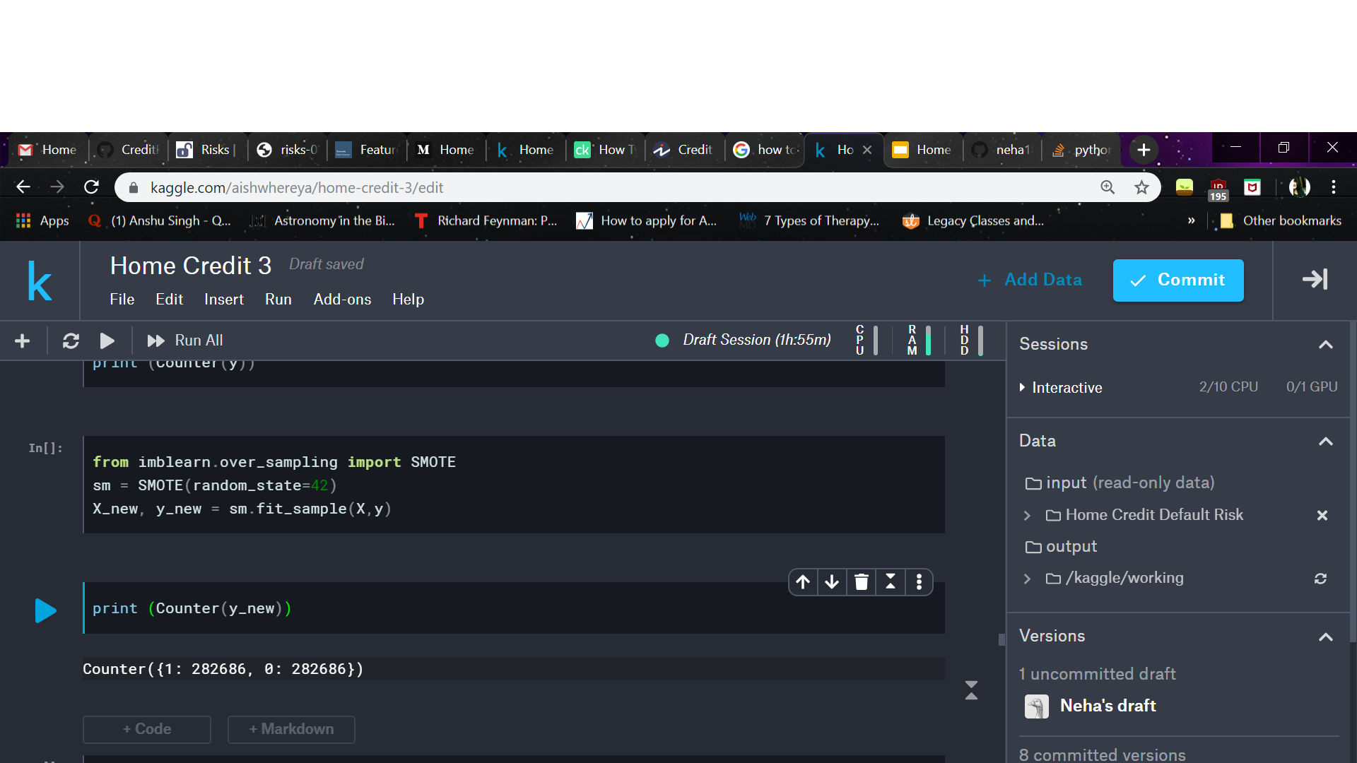
Data Pre-Processing
Flat File generated by merging data from 7 CSVs
Imputation of missing values : using median values
One-hot encoding of categorical columns
Scaling of data using MinMaxScaler
Splitting into train-test-val in the ratio of 0.6 : 0.2 : 0.2
Class balancing result using SMOTE -

Slide 9
Model Building
Machine Learning Models
Logistic Regression
Random Forest
Xtreme Gradient Boost
Deep Learning Models
DLM1
DLM2
DLM3

Slide 10
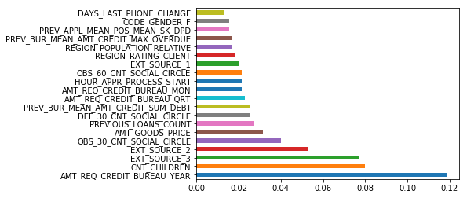
Feature Importance

Slide 11
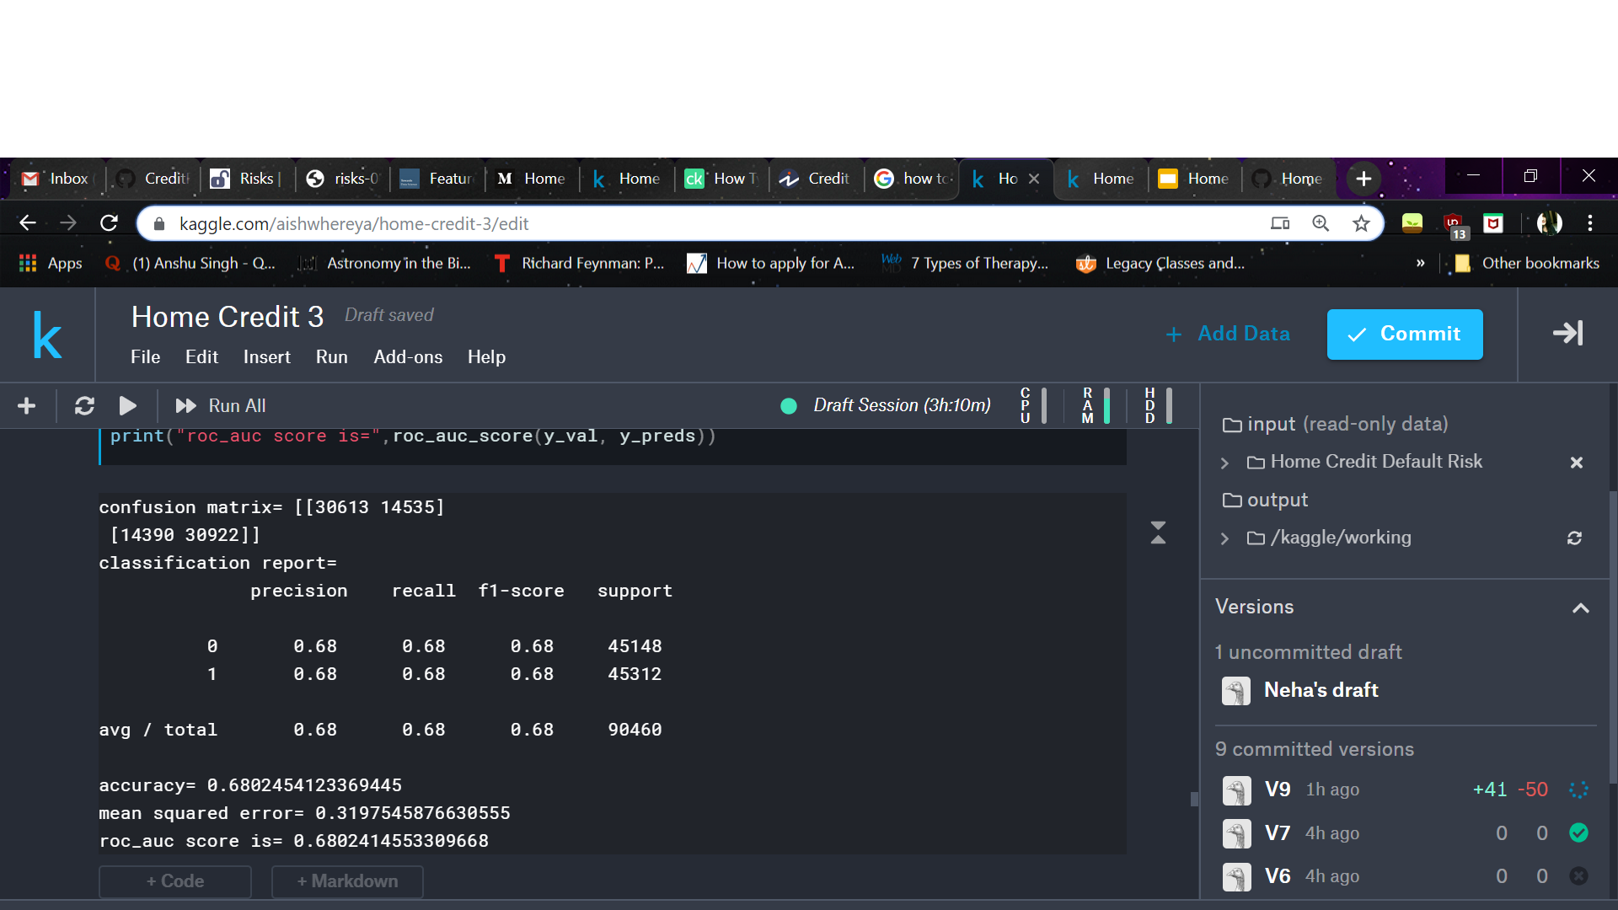
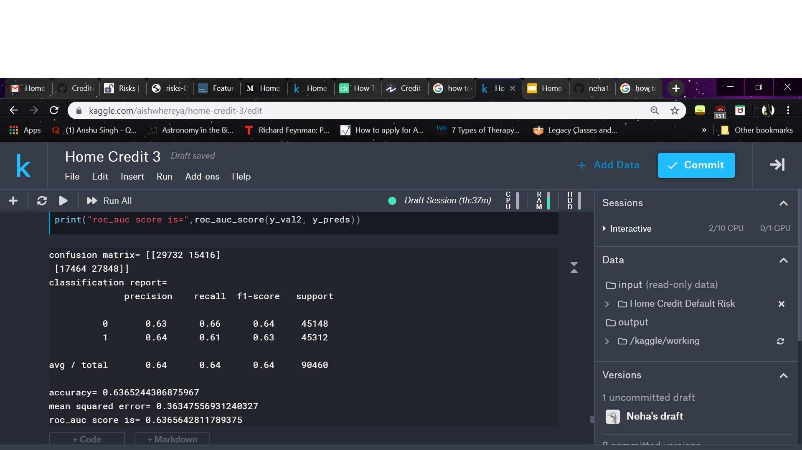
Results For Logistic Regression
With all features
With 20 features

Slide 12
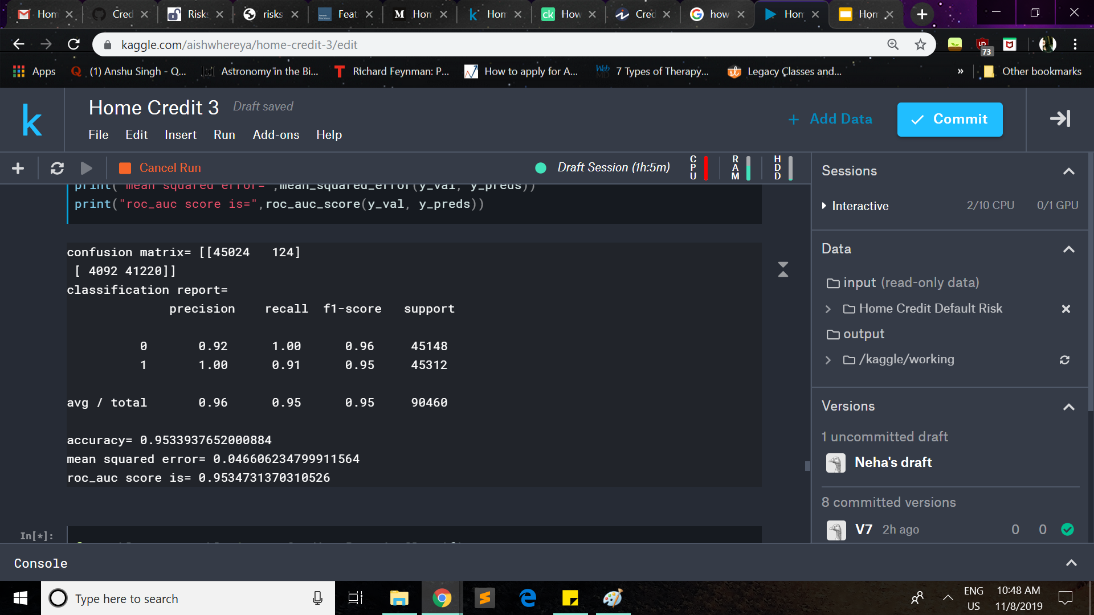
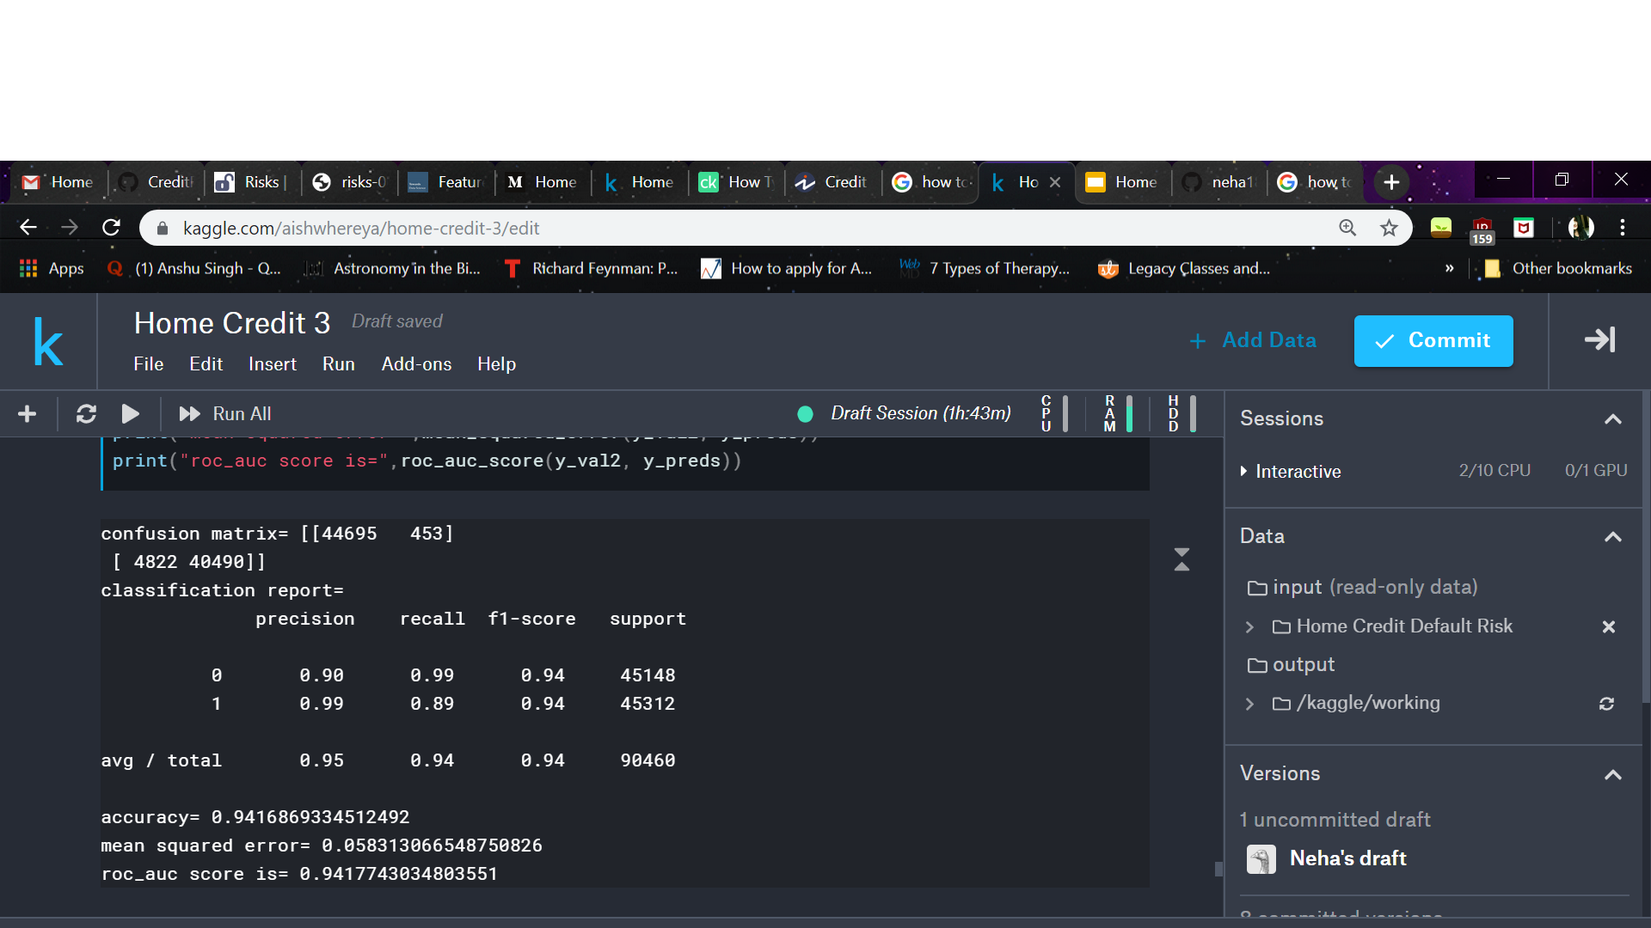
Results For Random Forest
With all features
With 20 features

Slide 13
Results of Deep Learning Models
Model | Training RMSE | Validation RMSE
DLM1 | 0.265 | 0.269
DLM2 | 0.265 | 0.279
DLM3 | 0.271 | 0.269

